Slide 1




NEXT GEN EMPLOYABILITY PROGRAM
Creating a future-ready workforce
Team Members
College Name
Student Name : E. Santhiya
Student ID : 623521104048
AVS College of technology, Salem

Slide 2

CAPSTONE PROJECT SHOWCASE
Project Title
Building Bus Reservation System using Python and Django
Abstract | Problem Statement | Project Overview | Proposed Solution | Technology Used | Modelling & Results | Conclusion

Slide 3
Abstract
The Bus Reservation System is a software application designed to streamline the process of booking bus tickets for passengers and managing bus operations for administrators. It offers a user-friendly interface for customers to search for available buses based on source and destination, view schedules, select seats, and make bookings. Administrators can efficiently manage bus routes, schedules, seat availability, and bookings through the system's administrative dashboard. By automating ticket booking and management tasks, the Bus Reservation System aims to enhance the overall efficiency and convenience of bus travel for both passengers and operators.
Source :

Slide 4
Problem Statement
The traditional process of booking bus tickets involves manual intervention, long queues at ticket counters, and limited accessibility to schedule information. Additionally, bus operators face challenges in managing routes, schedules, seat availability, and bookings effectively. These inefficiencies result in inconvenience for passengers and operational difficulties for bus companies.
The Bus Reservation System aims to address these challenges by providing a comprehensive solution for both passengers and administrators. For passengers, the system offers a user-friendly platform to search for available buses, view schedules, select seats, and make bookings conveniently online. For administrators, the system provides tools to manage bus routes, schedules, seat allocations, and bookings efficiently, thereby optimizing operational processes and improving customer satisfaction.
By automating and centralizing the bus ticketing process, the Bus Reservation System seeks to enhance the overall experience of bus travel for passengers while streamlining operations for bus operators.
Source :

Slide 5
Project Overview
The Bus Reservation System is a user-friendly platform facilitating seamless booking for passengers and efficient management for administrators. Passengers can easily search for buses, view schedules, select seats, and securely complete bookings online. Administrators can manage routes, schedules, seat allocations, and bookings with ease, accessing detailed sales reports for performance analysis. Built with Python and Flask, the system ensures robust functionality and scalability. It aims to enhance passenger convenience through real-time updates and operational efficiency for administrators. With core features like booking management and route scheduling, it sets the stage for future enhancements such as payment integration and mobile app support, promising a transformative experience for both passengers and operators.
Source :

Slide 6
Proposed Solution
The Bus Reservation System offers a comprehensive solution to the challenges faced in the traditional bus ticket booking process. By leveraging modern technology, the system provides passengers with a user-friendly platform to search for buses, view schedules, select seats, and book tickets securely online. For administrators, it streamlines operations by allowing them to manage routes, schedules, seat allocations, and bookings efficiently through a centralized dashboard. The system is built using Python with Flask framework for robust backend functionality and utilizes SQLite for reliable data storage. With a focus on enhancing passenger convenience and optimizing bus operations, the Bus Reservation System stands as a transformative solution poised to revolutionize the bus travel experience for both passengers and operators.
Source :

Slide 7
System Architecture and Technologies
Database Design and Management
User Interface and Experience
Security and Authentication
Functionality and Features
Scalability and Performance Optimization
Testing and Quality Assurance
Source :

Slide 8


Technology Used
Front-end
Back-end
Source :

Slide 9
Modelling & Results
Data Modeling and Database Design:
Entity-Relationship Modeling
Database Schema Design
Optimization Techniques
System Architecture and Design:
Layered Architecture
Scalability and Modularity
Performance Considerations
Testing and Validation:
Test Planning
Testing Techniques
Validation and Verification
Performance Evaluation and Analysis:
Performance Metrics
Performance Testing
Results Analysis and Optimization
Source :

Slide 10
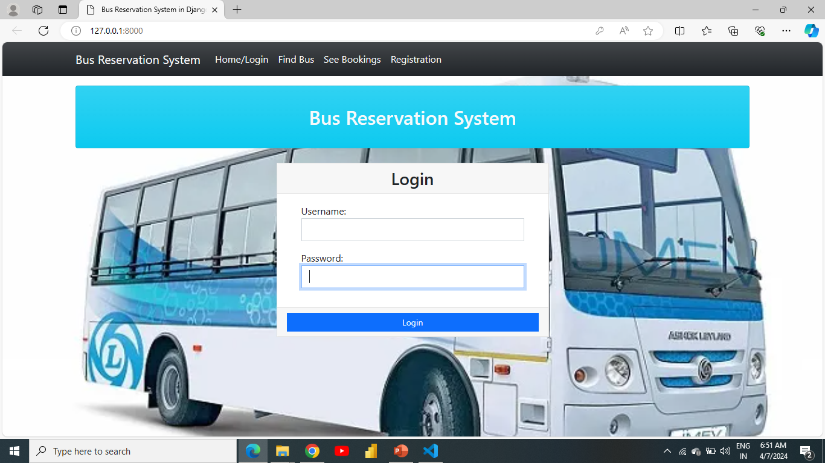
Homepage

Slide 11
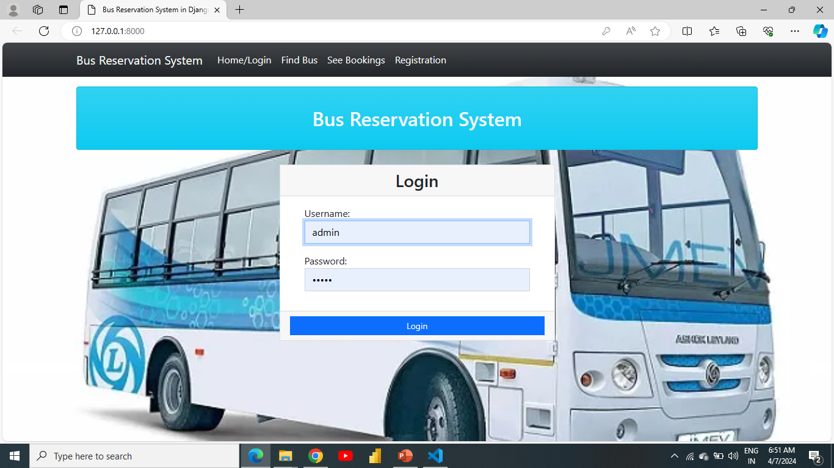
About-Us-Page

Slide 12
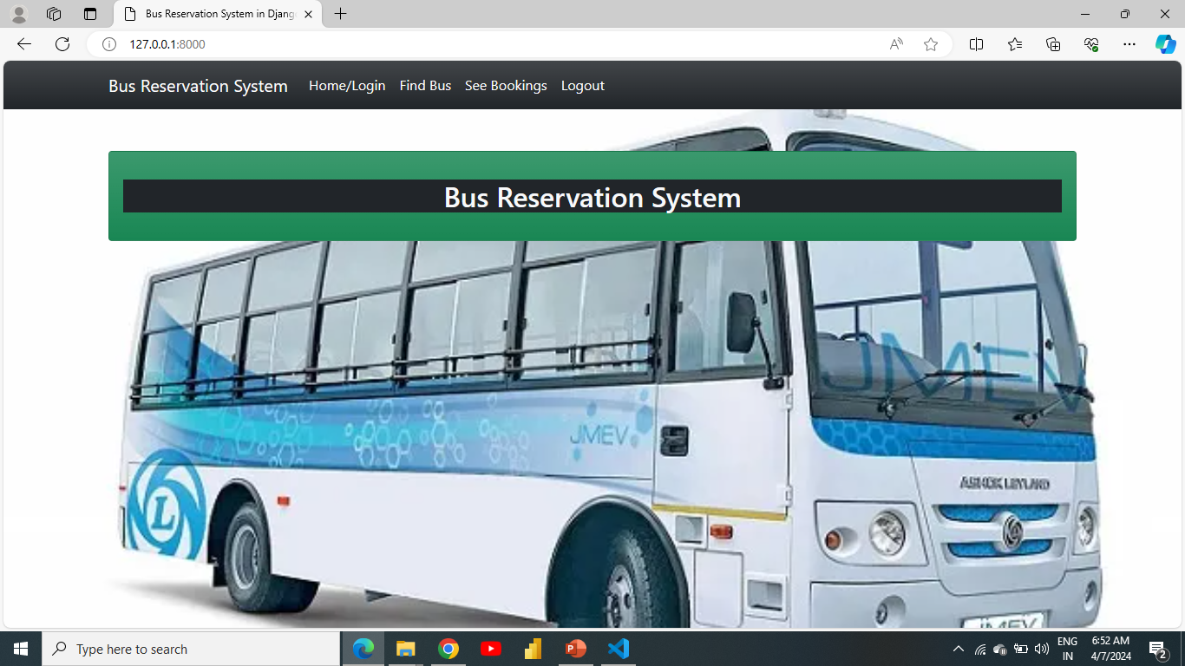
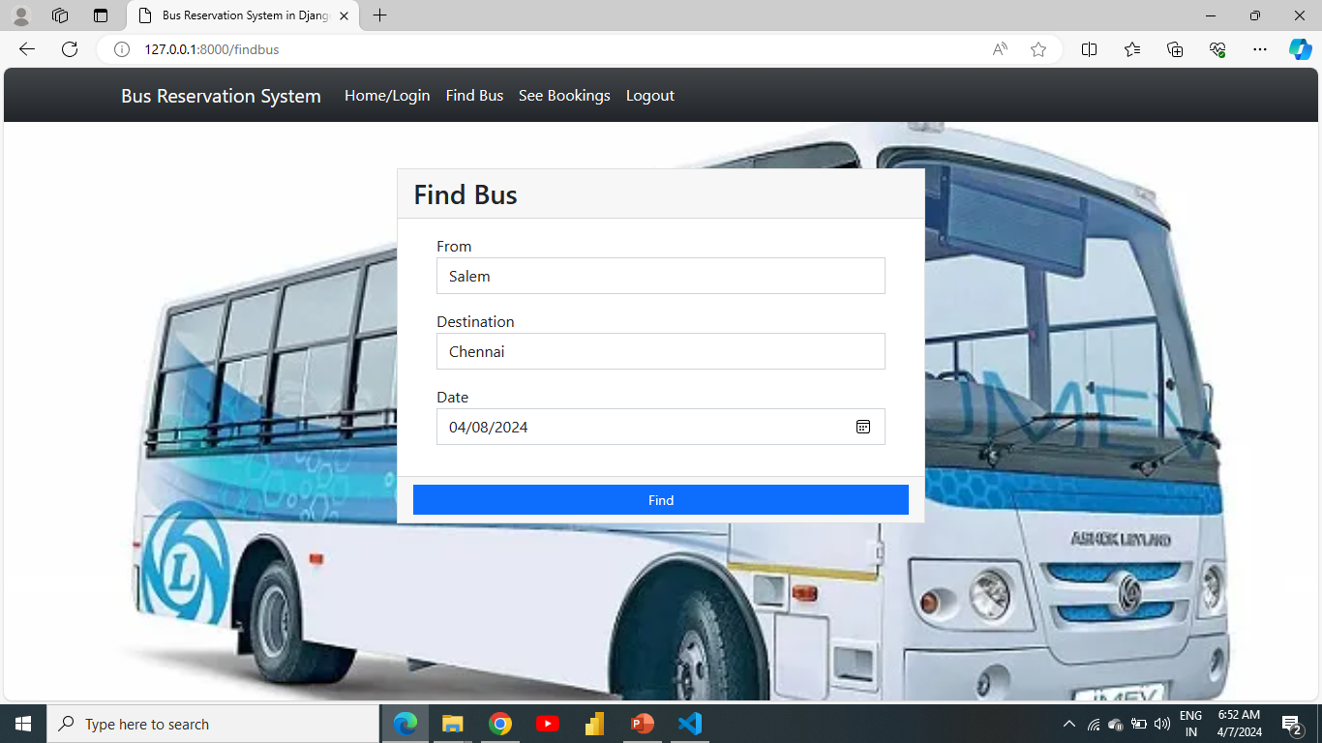
Service-Page

Slide 13
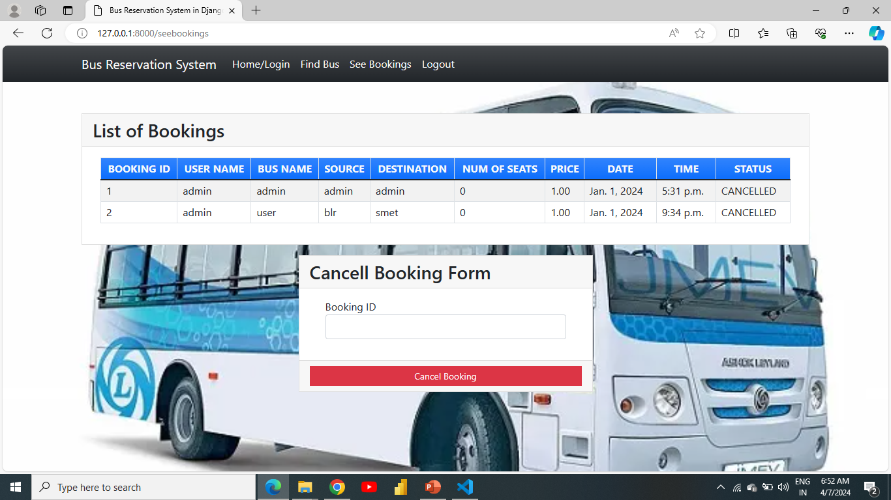
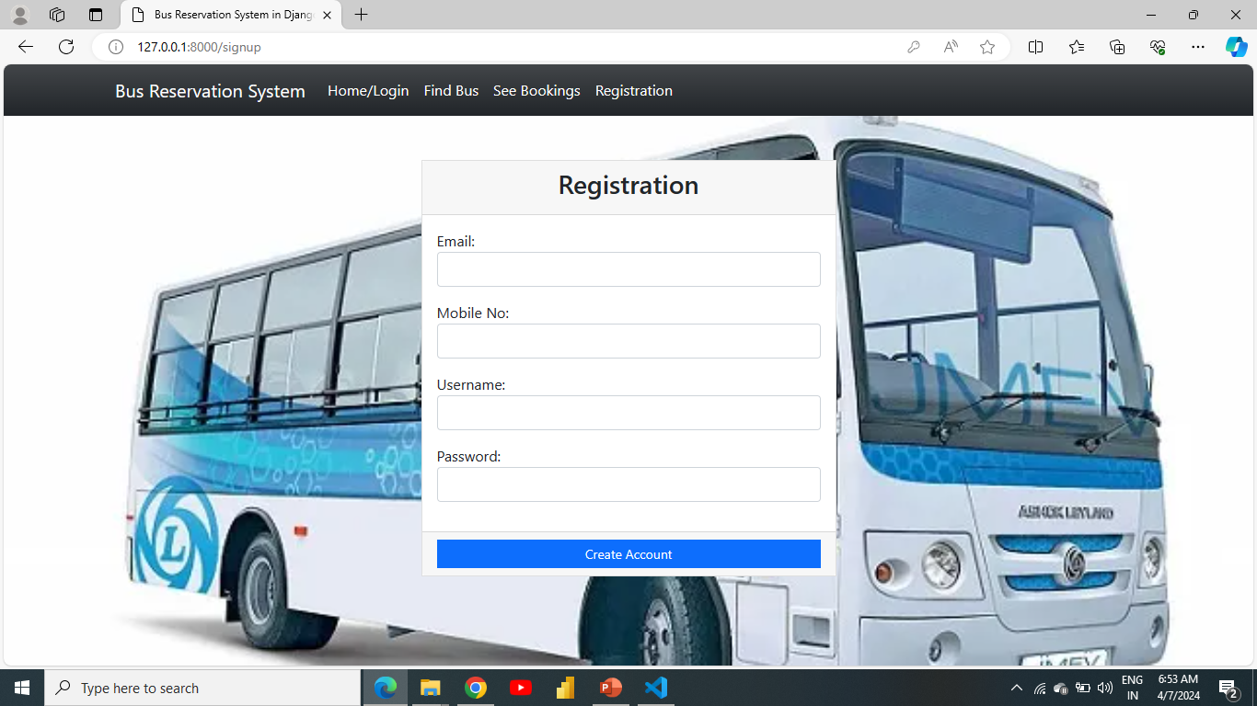
Departments-Page

Slide 14
Future Enhancements:
Real-time GPS Tracking: Integrate GPS tracking to provide passengers with live updates on bus locations and estimated arrival times, enhancing travel experience and customer satisfaction.
Payment Integration: Introduce seamless payment options, including digital wallets and online banking, to simplify the booking and payment process for passengers.
Mobile App Support: Develop mobile applications for iOS and Android platforms, allowing passengers to access the system conveniently from their smartphones and tablets.
Customer Feedback System: Incorporate a feedback mechanism to gather insights from passengers, enabling continuous improvement and refinement of the system based on user suggestions.
Social Media Integration: Enable sharing of travel plans and bookings on social media platforms, increasing visibility and attracting new customers through word-of-mouth marketing.

Slide 15
Conclusion
In summary, the Bus Reservation System offers a streamlined solution for both passengers and administrators. Passengers benefit from a user-friendly interface for booking tickets and viewing schedules, while administrators can efficiently manage routes, schedules, and bookings through a centralized dashboard. Built with Python and Flask, the system ensures reliability and scalability.
By enhancing convenience for passengers and optimizing operations for administrators, it promises to revolutionize the bus travel experience. With ongoing improvements and potential future enhancements, such as payment integration and mobile app support, the Bus Reservation System stands as a pivotal innovation in the transportation sector.
Source :

Slide 16
Thank You!
Notes:
Thank You !!

